Slide 1
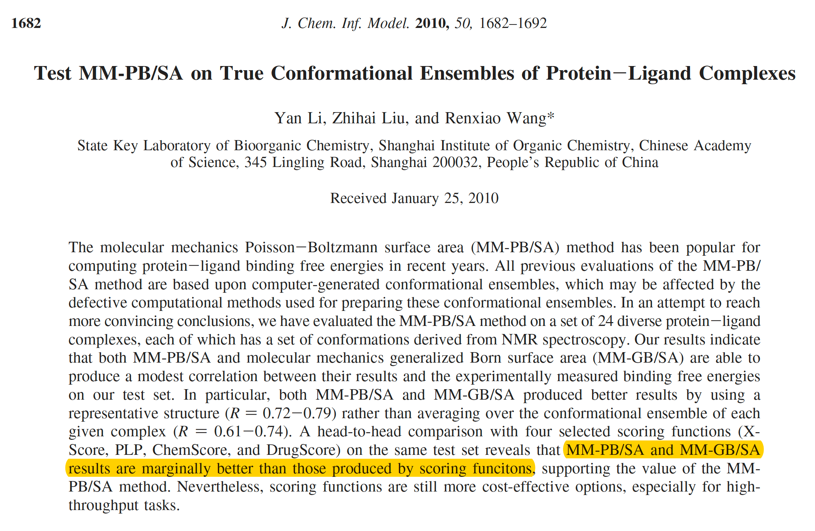

Slide 2
One-Trajectory and Three-Trajectory Methods
One-trajectory
Three-trajectory

Slide 3
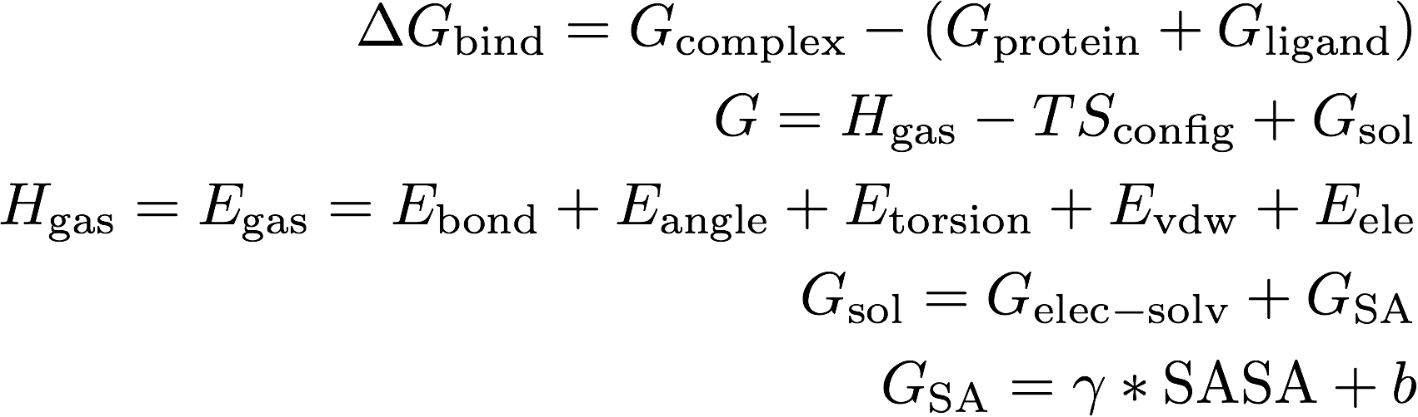

MM-PB/SA and MM-GB/SA Models
-- Electrostatic component of solvation-free energy
can be computed using a Poisson-Boltzmann (PB)
or a generalized Born (GB) model

Slide 4
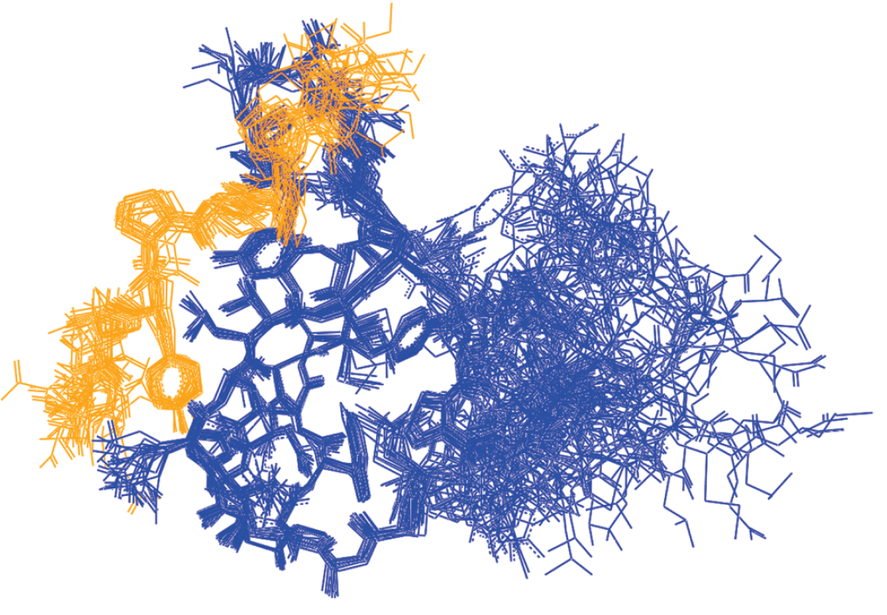

Slide 5
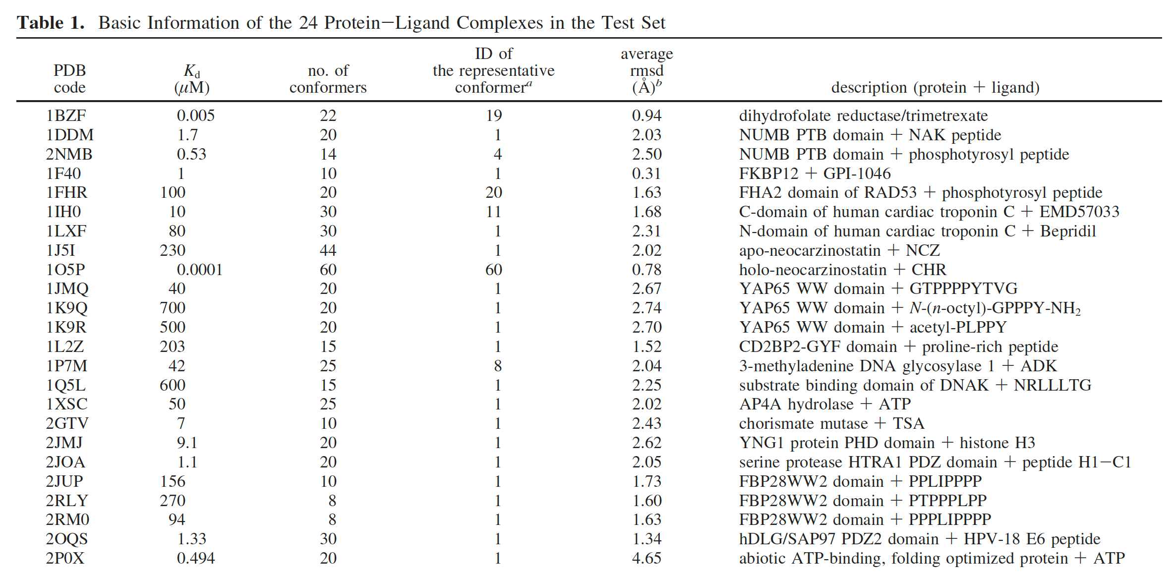

Slide 6
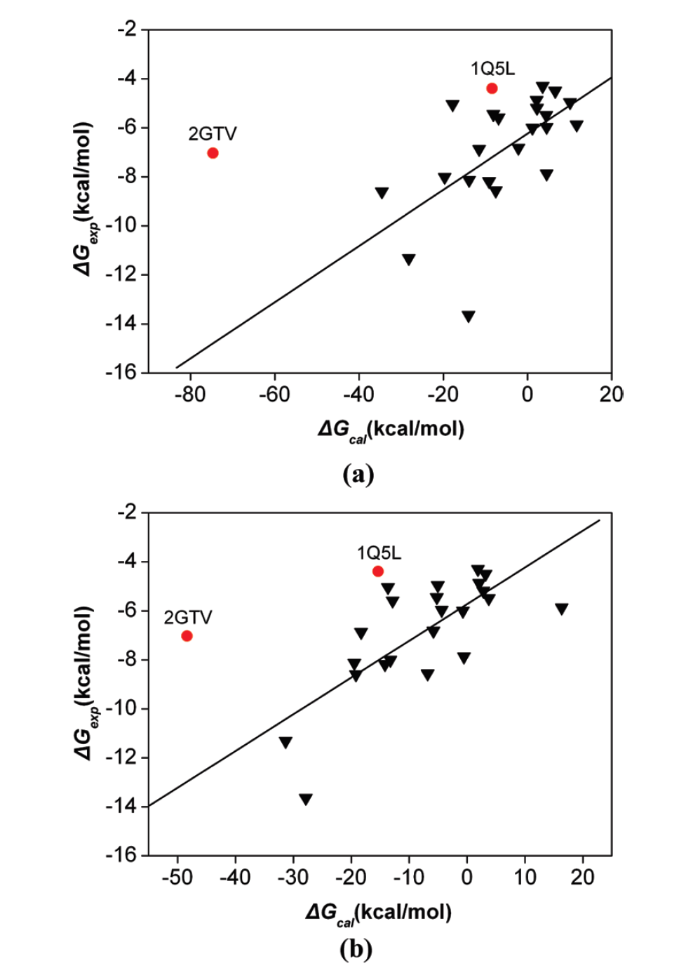
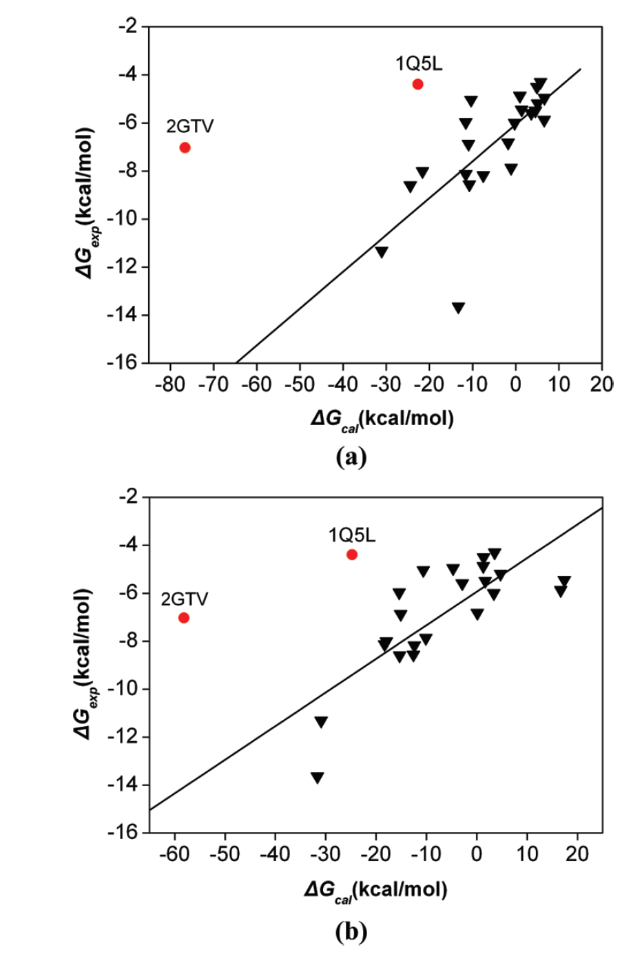
Conformational Ensembles
(Method 1)
Representative Conformation
(Method 2)
MM-PB/SA
MM-GB/SA

Slide 7
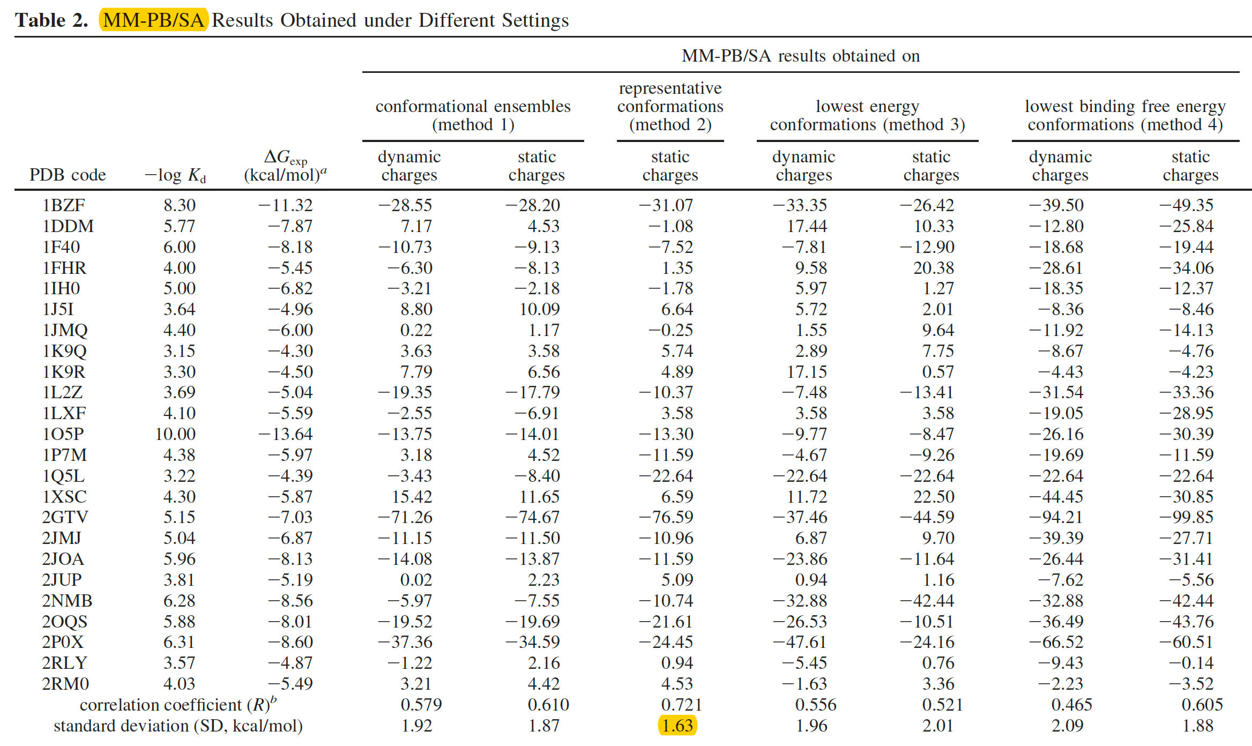

Slide 8
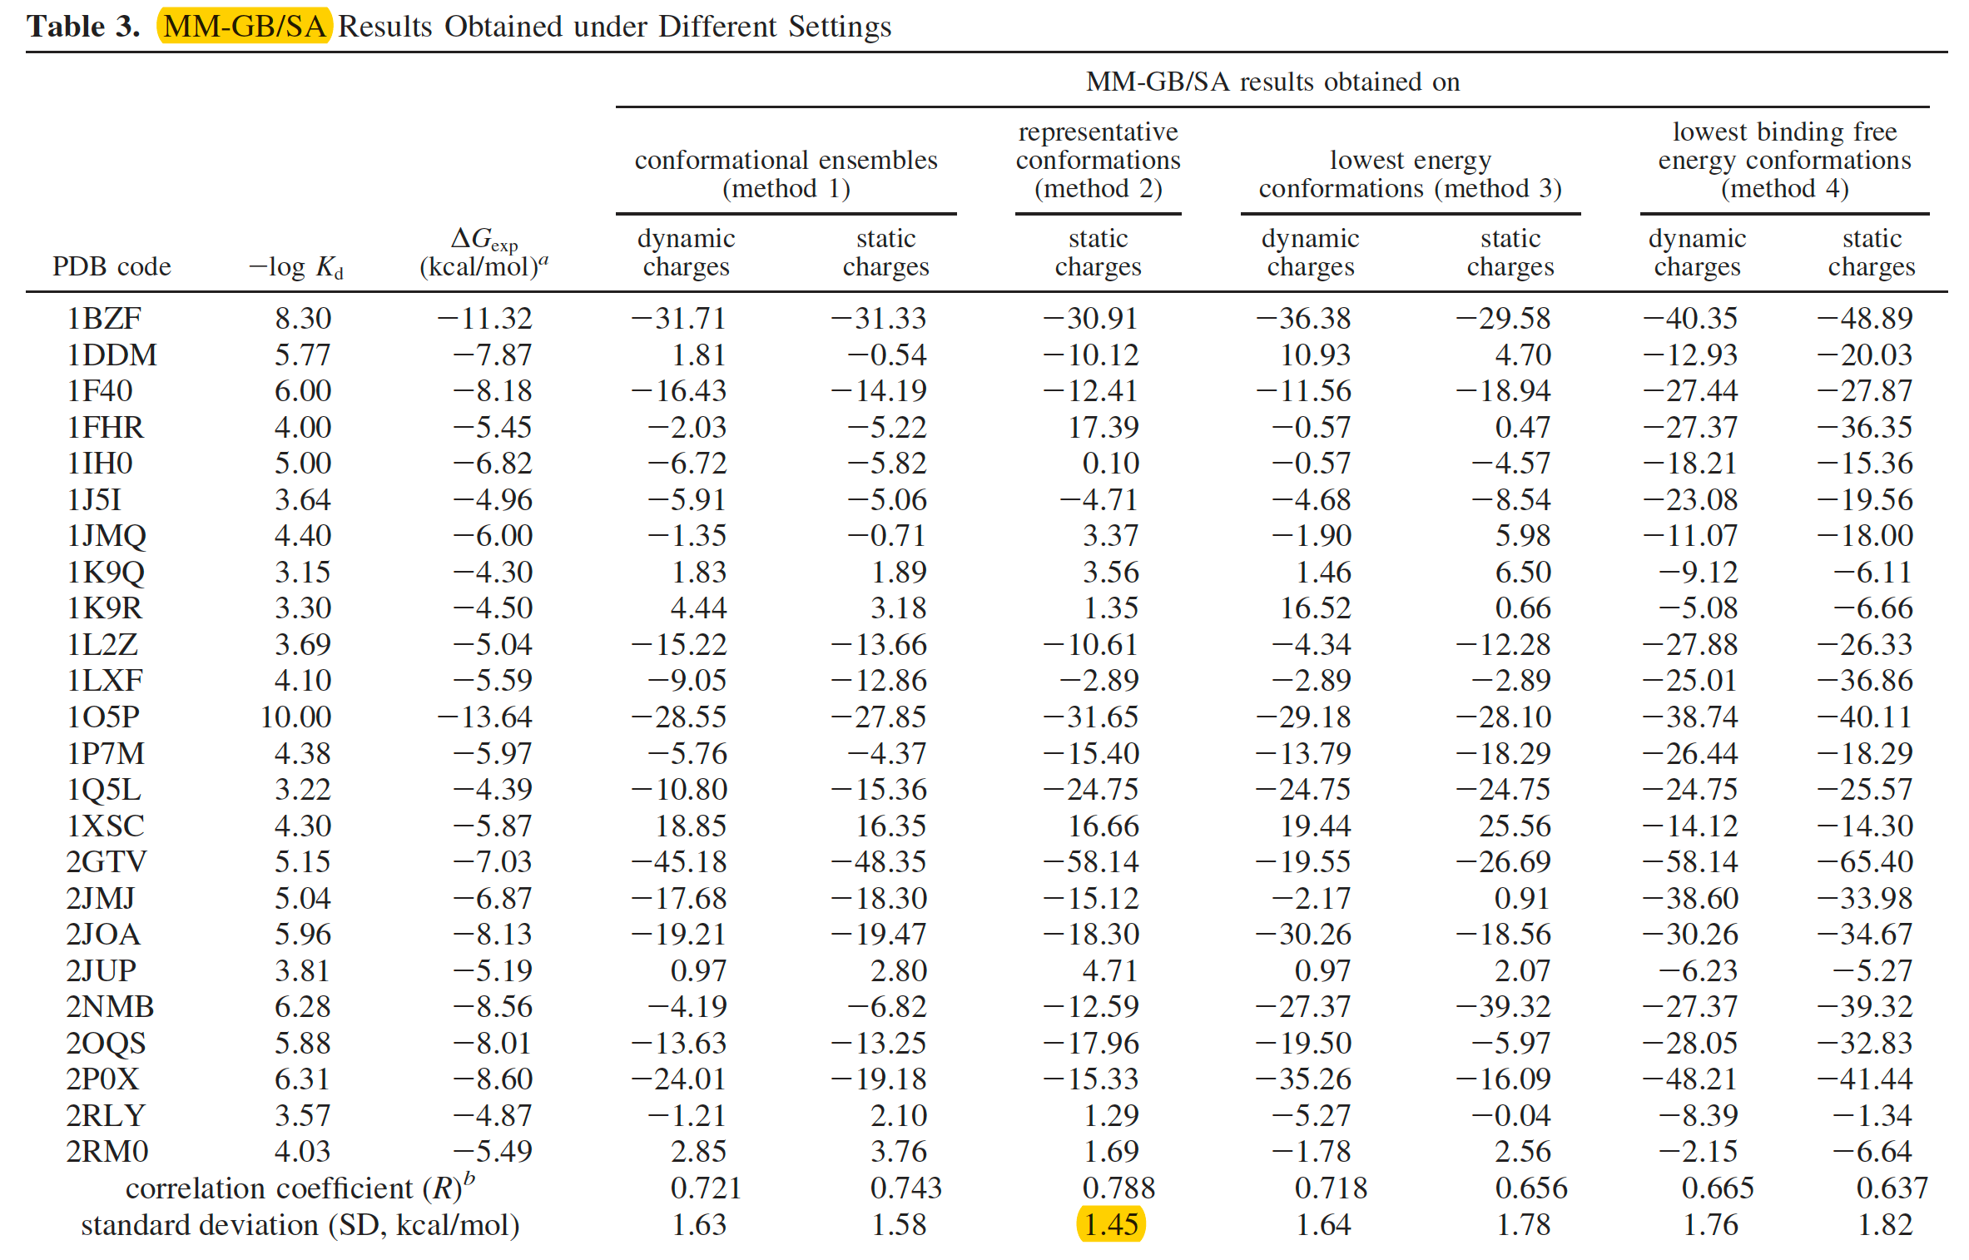

Slide 9
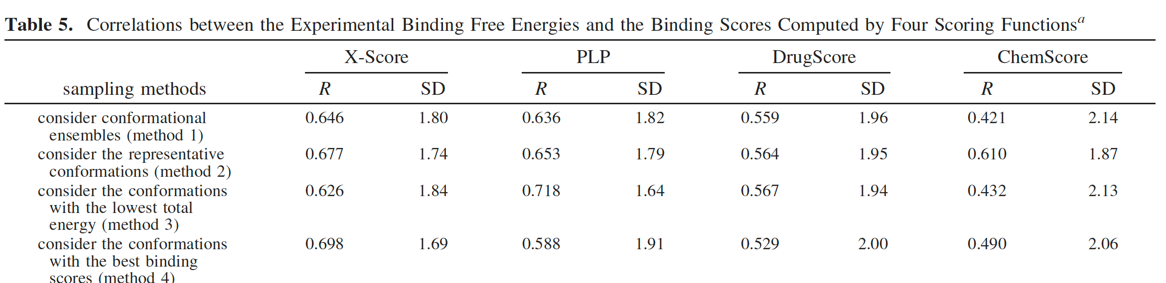

Slide 10
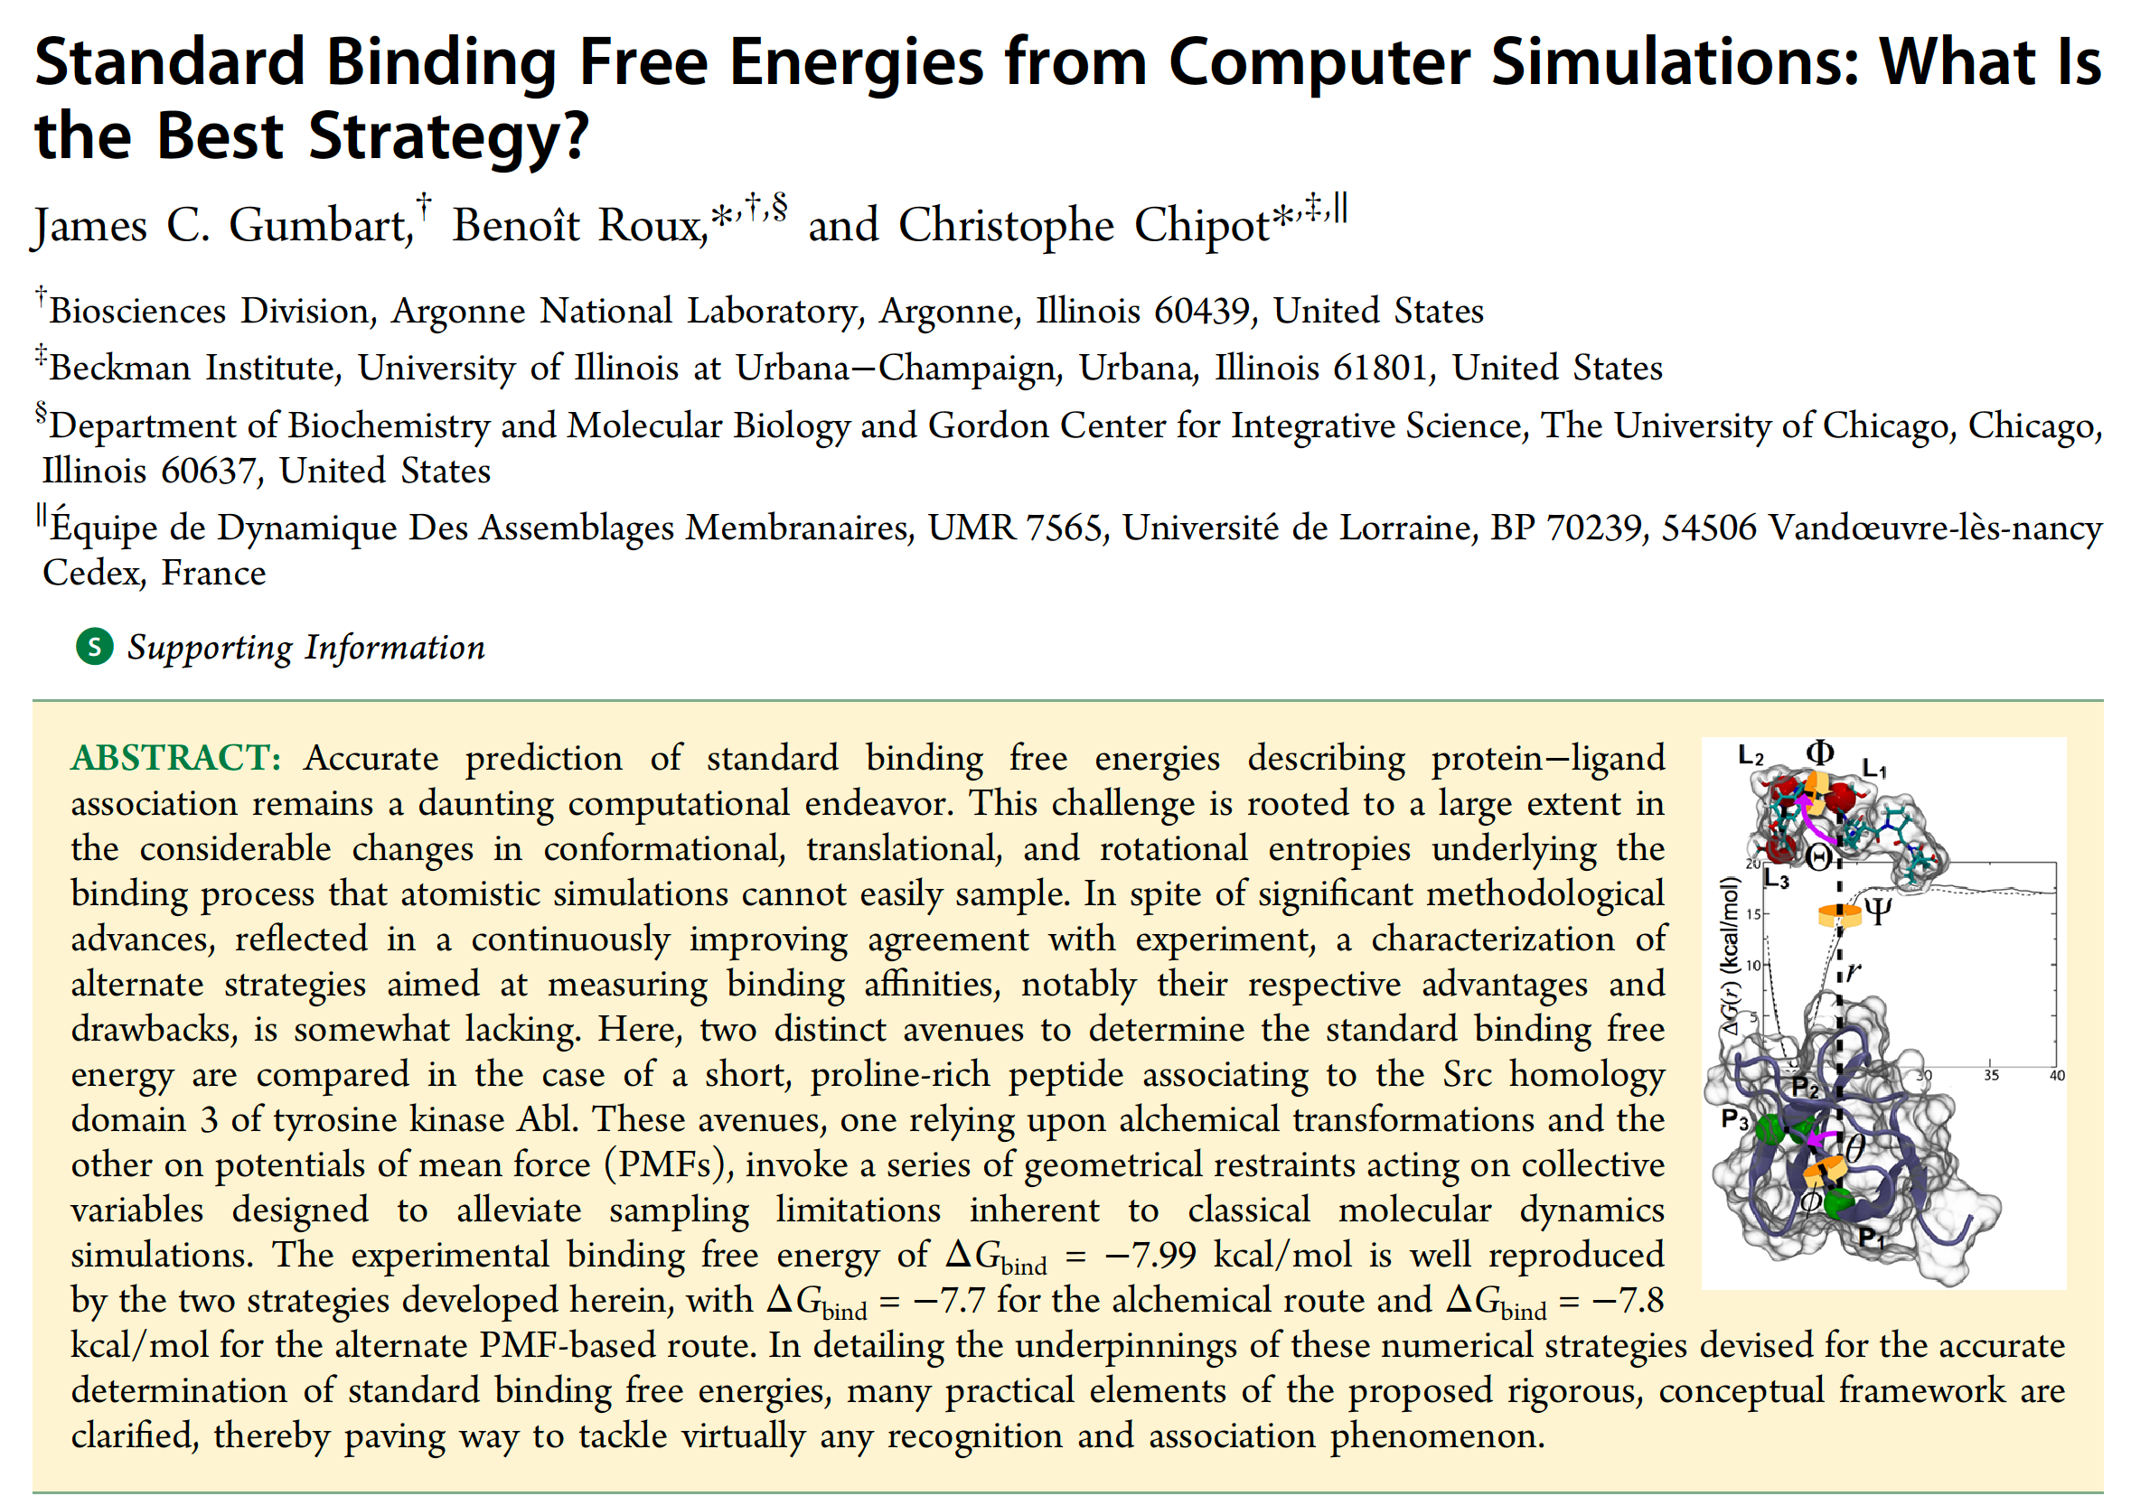

Slide 11
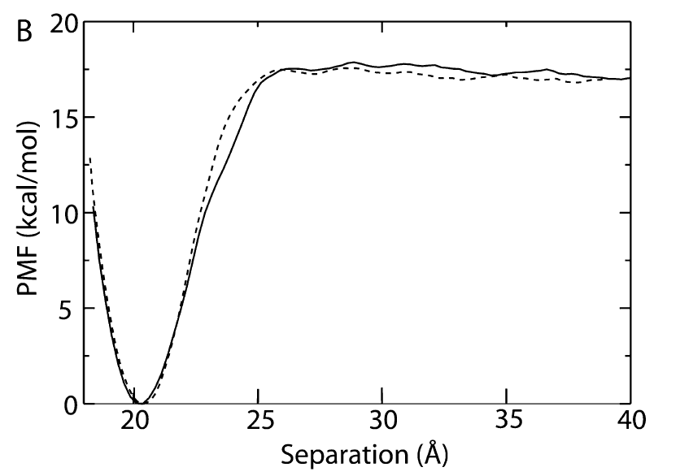
Potential of Mean Force

Slide 12
